Slide 1



Full Circle Detection
From Hunting to Actionable Detection

Slide 2

Bio
Mathieu Saulnier
Tech Director Advanced Security at Syntax
Core Mentor @BlueTeamVillage
Threat Hunting Adversary Detection
Talks at : Derbycon, BTV, NorthSec, SecTor & BSides
@ScoubiMtl

Slide 3
The Process
Idea
Build Detection
Share Detection
Continuous Testing
Training
Generate Events
IR Playbook
Notes:
I have seen many talks about various part of this, but I haven’t seen any talks that puts it all together like this. This is why I decided to come share with you all what I call Full Circle Detection

Slide 4
Security Functions
Planning & Direction
Collection
Processing
Analysis
Dissemination & Feedback
Threats & Trends
Idea
Analytic
Share Detection
Continuous Testing
Training
Test Detection
IR Playbook
Discover
Prioritize
Report
Remediate
Assess
Verify
Vulnerabilities
Threat Intel
Detection Engineering
Vuln Management
Threats & Trends
Vulns & Miss Config
Threats & Trends
Effective Queries
Vulns & Miss Config
TTPs
Detect
Analyze
Contain
Eradicate
Recover
Post Mortem
Recon
Initial Access
Privilege Escalation
Lateral Movement
Persistence
Action on Objective
Hypothesis
Analysis
Document
Convert
Deep Dive
Incident Response
Offensive Security
Incidents
TTPs
Threat Hunting
Notes:
This slide is a new addition to the deck. I posted it on twitter a while back and many seemed to have found it useful so I thought I should add it. TH is fed by 1. TI 2. OffSec And the more complete view could look like this. TI feeds pretty much all aspect of security. So when people show these teams/function in a wheel, I have a bit of a problem with that. It 100% looks nicer, but I’m not sure how it works or how it should work. Roberto’s SANS TH Keynote

Slide 5

Notes:
This is Venom

Slide 6

The Idea / Hypothesis
There is a ton of places to get ideas for detection
Twitter
Mitre ATT&CK
Slack
BloodHound
ThreatHunting
Discord
TrustedSec
BHIS
BTV
Infosec News Site
Threat Intel Team

Slide 7

The Idea / Hypothesis
MDSEC
A Fresh Outlook on Mail Based Persistence
https://www.mdsec.co.uk/2020/11/a-fresh-outlook-on-mail-based-persistence/
Notes:
TL;DR : You can create a macro as the user to create a C2 via email. Each email that you receives with a certain keyword is deleted and than a command(VBScript) is executed (ie: Reverse Shell to your Infrastructure) In our test, it bypassed our EDR and we successfully pop calc.exe

Slide 8
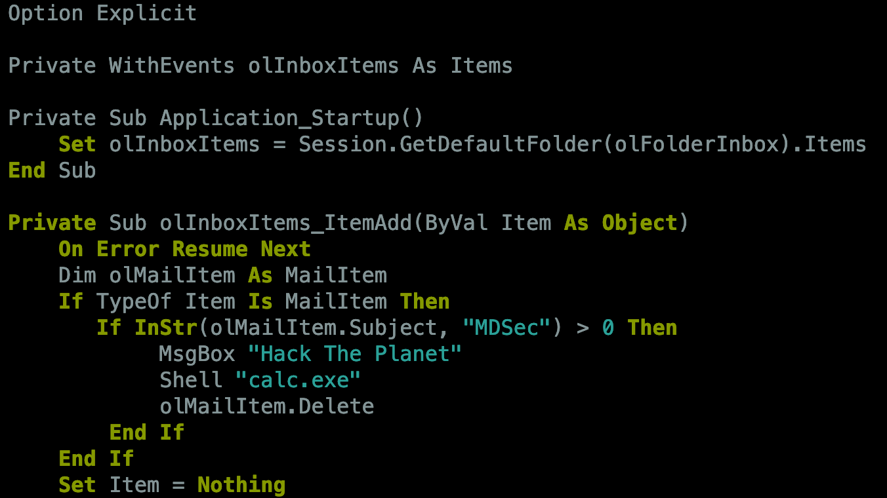
Notes:
VbaProject.OTM

Slide 9
Notes:
VbaProject.OTM

Slide 10
Detection
Monitoring of creation/modification events (Sysmon event ID 11) for the file
%APPDATA%\Roaming\Microsoft\Outlook\VbaProject.OTM
Monitoring for creation/changes events (Sysmon event ID 12) for the key
HKEY_CURRENT_USER\Software\Microsoft\Office\16.0\Outlook\Security
and value Level (1).
Notes:
Because MDSEC folks are so great they do include a DETECTION section in their articles. If you don’t have Sysmon, don’t leave, we can also detect this with a Good EDR or Windows Event Log

Slide 11
What We Did
Group Hunt
Planted Evidence
Book an hour learning meeting
Read the article
Look for the artifacts
Modify the registry
Edited VBAProject.OTM
Sent a mail
Hunt again
Notes:
e have those every second week
In our test, it bypassed our EDR and we successfully pop calc.exe Everyone learned something that day regardless of their level or seniority. I was rather new at that time and I never really worked with our toolset. So things that would have take me 5 or 10 minutes in other tools were challenging.

Slide 12


Slide 13

Generate the Event(s)
Did you find any events?
How can we easily generate events?
Atomic Red Team
github.com/redcanaryco/atomic-red-team
Notes:
It’s not because you didn’t find any event that your query is not good. In fact, we don’t want to have any hit It’s not practical to go and manually edit a macro each time we want to test our detection

Slide 14
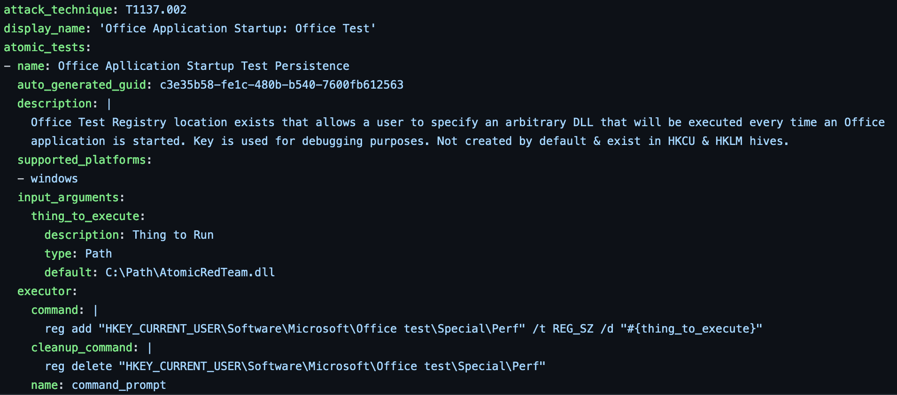
How To Build an ART?
Notes:
This an existing YAML file

Slide 15
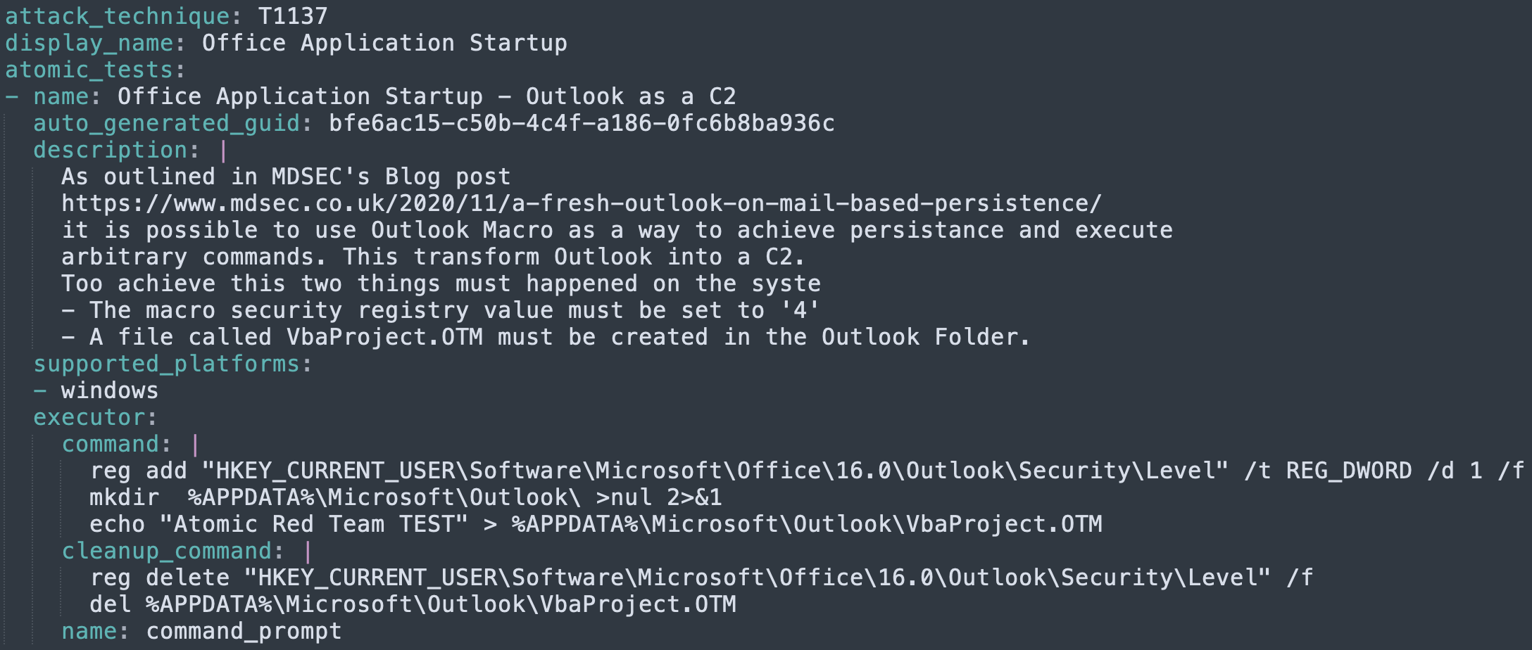
How To Build an ART?
Notes:
Took me about 15 minutes to build my first ART script.
Building this test actually allowed me to find a small typo in Dominic’s blog.
And I think this is important. If you don’t test it, you won’t know how it work.
If you just created a detection for what’s in the blog, you would have had a false sense of security
Because you would expect your detection to work, when in fact, it would be monitoring a folder that doesn’t exist.

Slide 16
How To Build an ART?
Notes:
Building this test actually allowed me to find a small typo in Dominic’s blog.
And I think this is important. If you don’t test it, you won’t know how it work.
If you just created a detection for what’s in the blog, you would have had a false sense of security
Because you would expect your detection to work, when in fact, it would be monitoring a folder that doesn’t exist.

Slide 17
How To Build an ART?
Notes:
Here the test is blindly deteling both the file and the registry key
PRO TIP : Do not run ART scripts on production servers!! You never know what important file / registry might get modified or deleted if you do the clean up The clean up is meant to bring the system back to a state where you can test your detection again and again and again
BTW if you create a test you will be featured in their News Letter. That’s pretty cool ☺ And you might get a t-shirt as well. So double incentive

Slide 18

Convert Hunt to Detection
Refine/Optimize Query
Select Output
Alert / Ticket
Report
Dashboard
Notes:
Follow the Google “Hunt Once” mantra.
Not all of your hunt/detection will be “Alert Worthy” Worthy, Thor, did you get the analogy?

Slide 19

Share Detection with Community
Sigma
github.com/SigmaHQ/sigma
Share the Detection Logic
Known OS Exclusion
Not Org specific Exclusion
Notes:
I’ve said it before, I will say it again : Red Teamers are sharing a lot more that the Blue Teamer and we, as Defenders, need to change this. I’m not saying to share intellectual properties, but for rules like this one, where the Detection is laid out in the blog post, I’m sorry, but it’s not YOUR Org intellectual property.
On the other hand, if you are using product X and it generate FP with this rule, you might not want to share that you are using product X, and that’s OK. Personnally, if I’m looking for a security partner, I’ll be a lot more likely to go toward a vendor that is sharing openly with the community than one that is telling me they cover 85% of the ATT&CK Framework without telling what they cover and more specifically HOW they cover it.

Slide 20
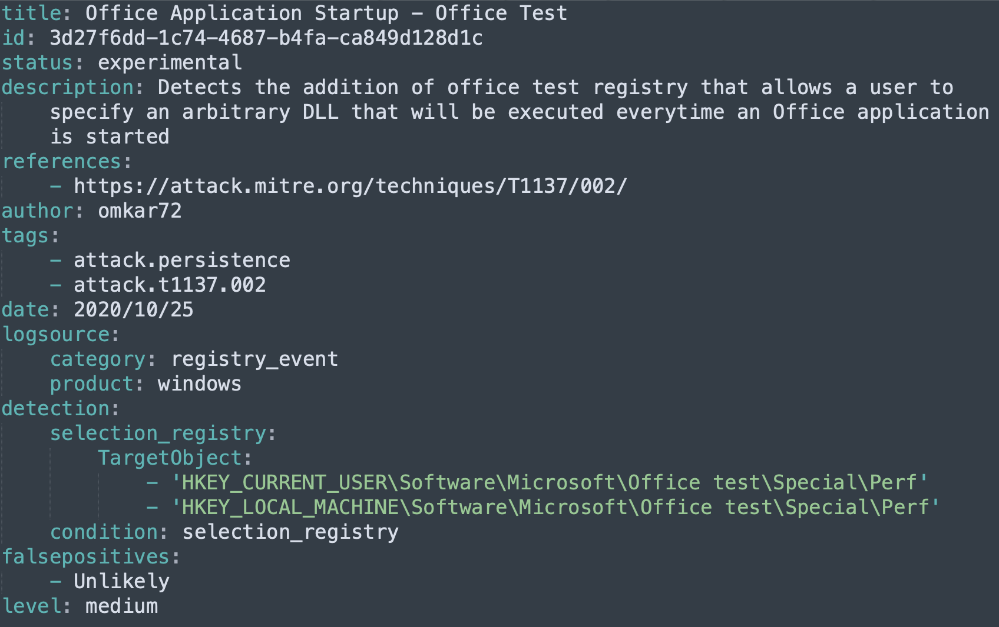
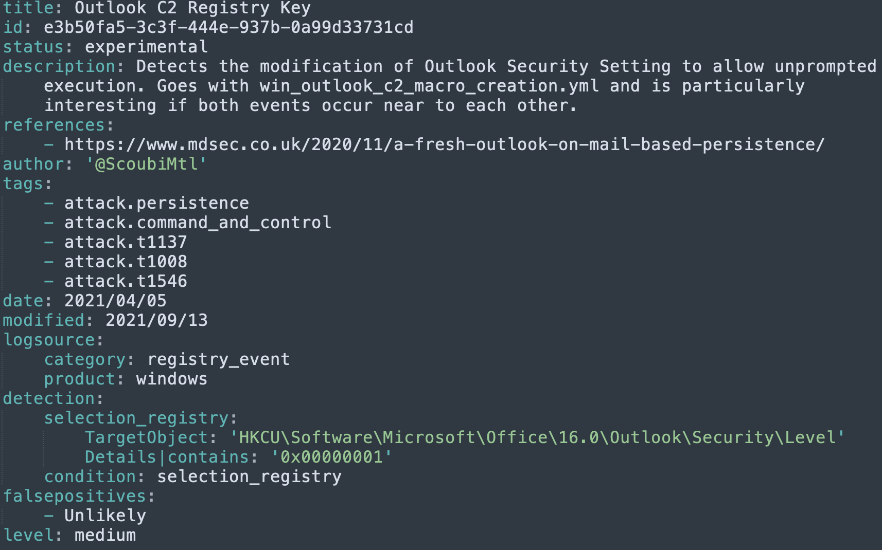
Create Sigma Rule
Existing Rule
Our Rule
Notes:
It took me literally 10 minutes to build this. The longest part was to find which TTP applied And how to generate the ID on line 2.
T1546 = Event Triggered Execution
T1008 = Fallback Channels

Slide 21
Notes:
The ID on top (the same as ART) is what took

Slide 23
Notes:
We set our key value to 1 to indicate that we want to run all the macro without warning

Slide 24
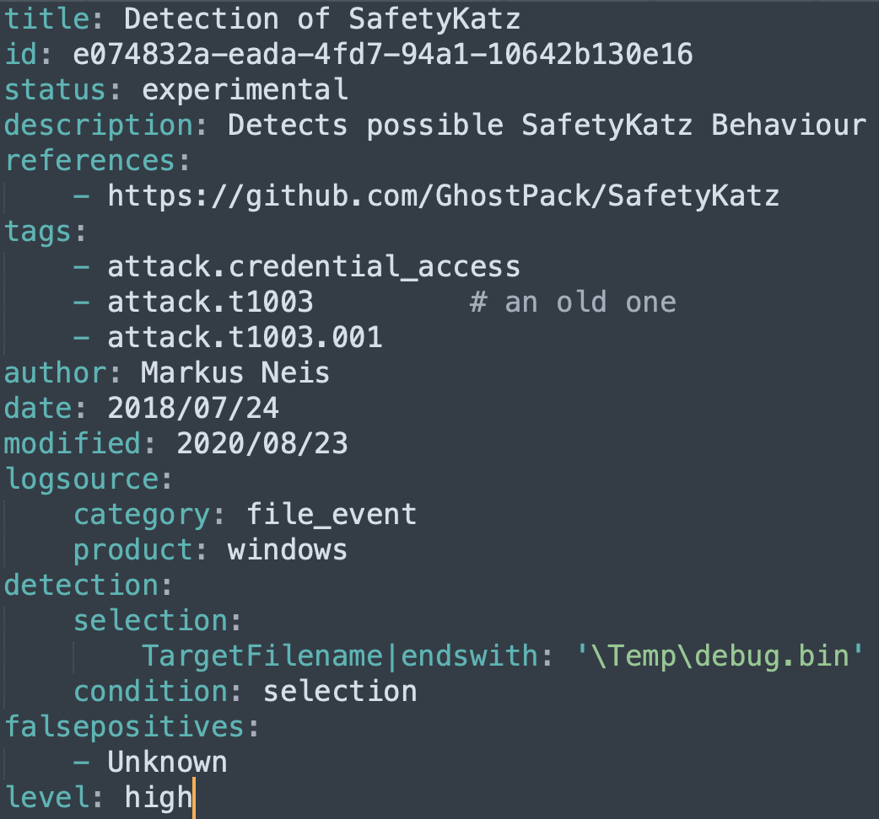
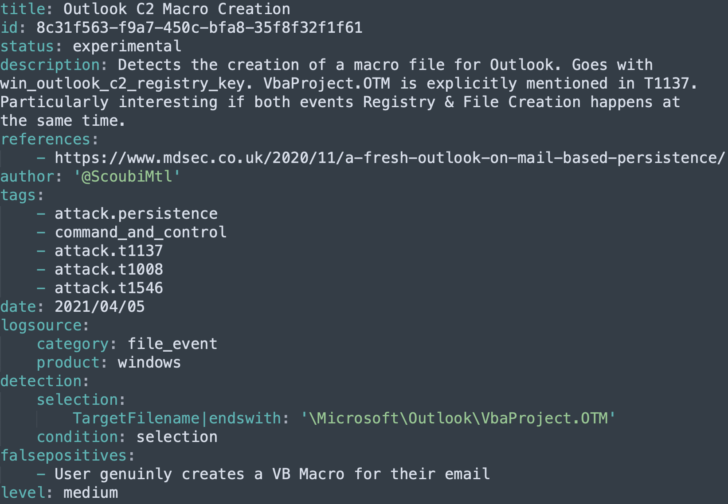
Create Sigma Rule
Existing Rule
Our Rule
Notes:
T1546 = Event Triggered Execution
T1008 = Fallback Channels
It took me literally 3 minutes to build this. The longest part was to find which TTP applied

Slide 25
Notes:
My first Sigma rules took me less than 10 minutes to create. The longest was to find the model for both and read how to generate the unique ID.
Who here can look me straight in the eyes and tell me they don’t have 10 minutes to help their fellow Defenders??

Slide 26
Notes:
My first Sigma rules took me less than 10 minutes to create. The longest was to find the model for both and read how to generate the unique ID.
Who here can look me straight in the eyes and tell me they don’t have 10 minutes to help their fellow Defenders?? Or even 30 minutes for the ART & Sigma rules

Slide 27
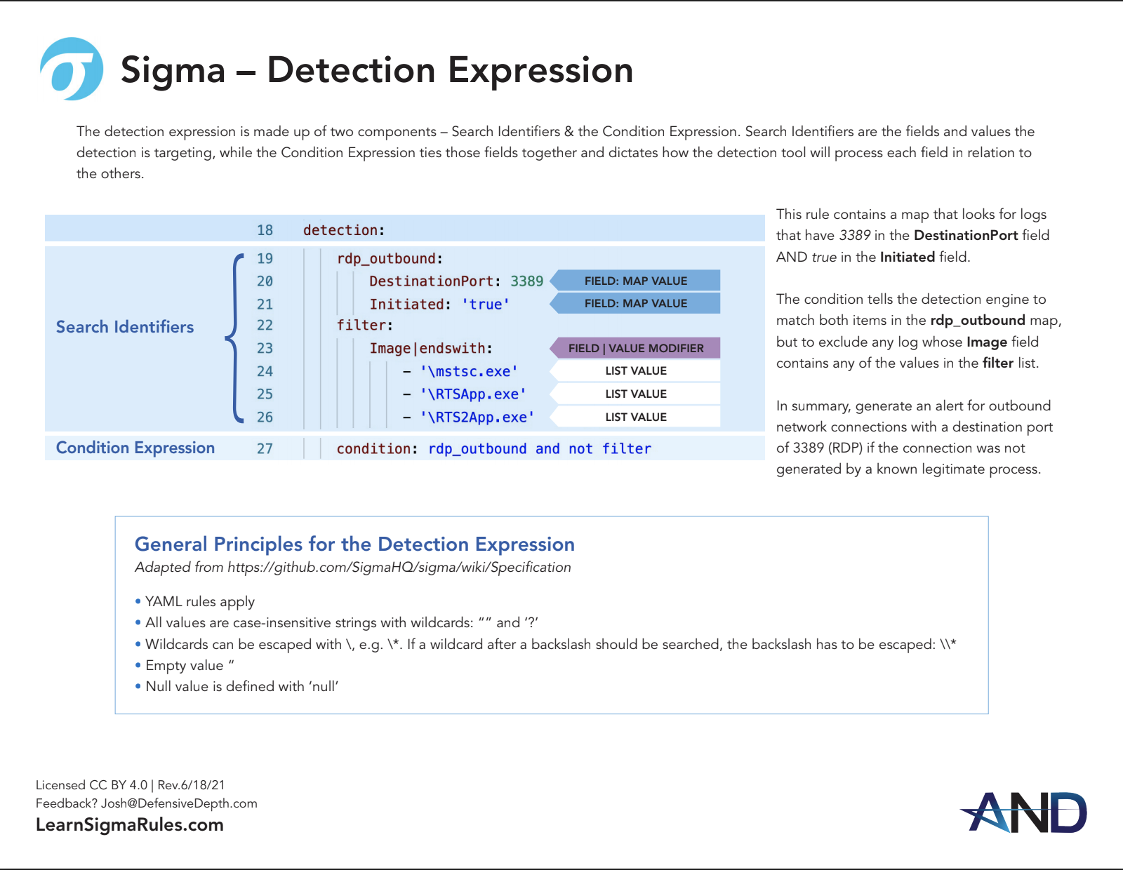
Chris & Josh
https://drive.google.com/file/d/1nayvP3m8GD8cxV_nrk6459mHDV2xaqFB/view
Notes:
Chris Sanders & Josh Brower from Active Network Defense
2 pagers to help understand how to build a Sigma Rule They also have a full class if you want to go deeper into how to build these. Full Disclosure I didn’t take the class

Slide 28
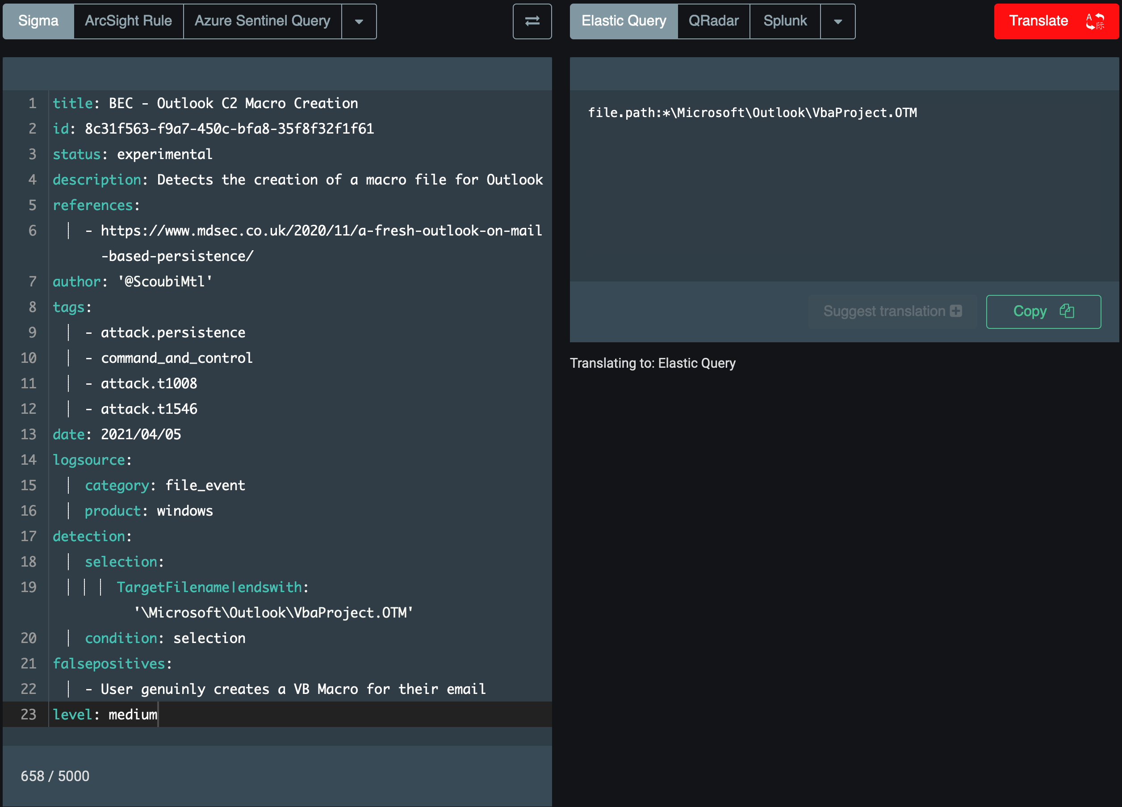
Pro Tip
uncoder.io
Notes:
file.path:*\Microsoft\Outlook\VbaProject.OTM You can also convert to Qradar, Splunk, ArcSight, ElastAlert and a bunch of others

Slide 29

Detection Pipeline
Make sure the whole chain is working
Run your ART often
Scheduled Tasks / Cron
Docker
Put the source system in Allow/Ignore list
Send the ticket to a test queue
blog.3coresec.com/2021/08/detection-as-code-dac-challenges.html
Notes:
It happened way too often in my career that a detection stopped working 1- New version of OS / Software
2- New version of the parser
3- SIEM changes field name or mapping
Etc. We put a lot of effort and pride in building detection, we should make sure they are working. From the event all the way to create a ticket Today I came across Automata, which seems very interesting. I haven’t tested but felt I should also include this in the deck

Slide 30

Incident Response Playbook
Process for SOC Analysts
Business E-Mail Compromise (BEC)
Notes:
And here I want to pause for a second and explain the difference for me between a Playbook and Work instructions or Microplays

Slide 31
Plan vs Playbooks vs Microplays
C-Level
INCIDENT RESPONSE PLAN
Ransom
BEC
Phish
Account Comp
SOC Manager
Submit Hash
VT HA
Retrieve PCAP
WAF IPS
Create User
EDR SIEM
Client Contact
Regular Off Hour Escalation
Isolate Endpoint
EDR Switch
Comm. Temp.
Clients
Internal
3rd Party
SOC Analyst
Notes:
The plan is for C-Level – They are either the Policy or the Standard Playbooks in the middle are For SOC Manager or Team Lead – They are the Process Microplays are for the Analysts – They are the Procedures
Of course, once analysts went through the procedures a few times they don’t need them anymore For me Playbooks are the middle layers

Slide 32
Two Open Frameworks
RE&CT
Syntax
atc-project.github.io/atc-react/
gitlab.com/syntax-ir/playbooks/
Released in July @SANS DFIR
youtu.be/52HA_Y8A1Zs
youtu.be/OEIFsGXvVVk?t=1525
Notes:
Release in July (SANS DFIR) The talk was recorded but is still only in the Conference portal AFAIK But 2 days before recording this I also presented the Playbooks at a Hackin Cast (from BHIS/Wild West Hacking Fest)

Slide 33
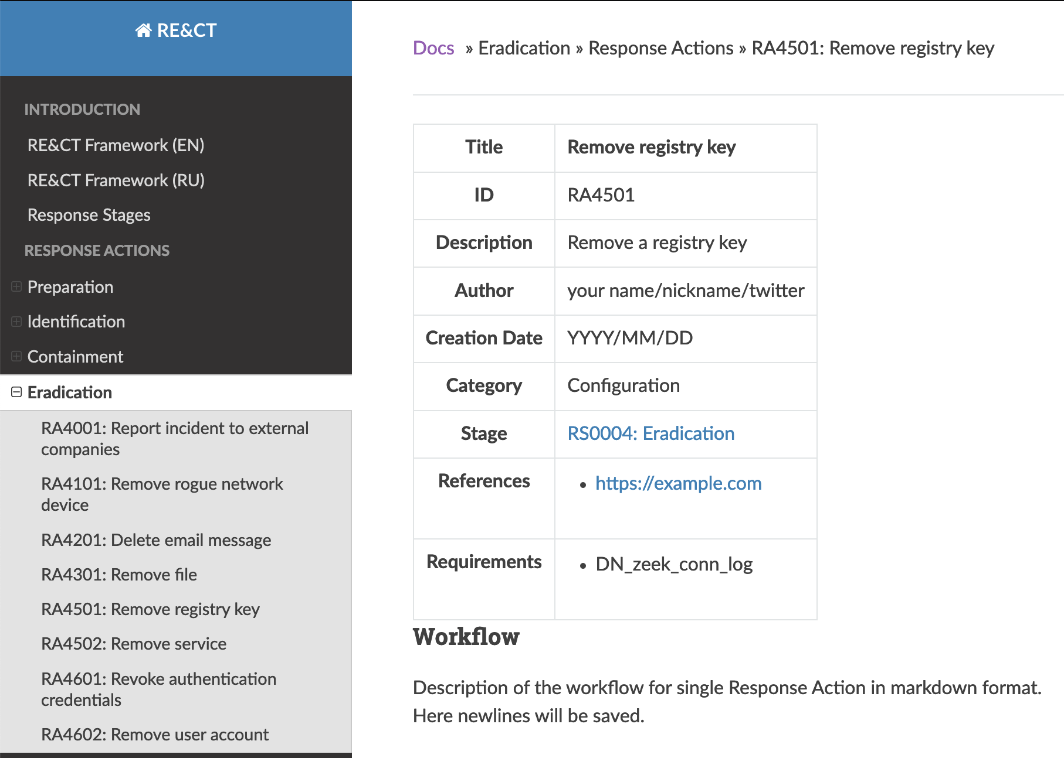
RE&CT
@atc_project
Modular
Open Source
Framework
WIP
Notes:
This one has a lot of potential
We talked about merging our projects, but we had slightly different agenda. We might reconsider in the near future.

Slide 34
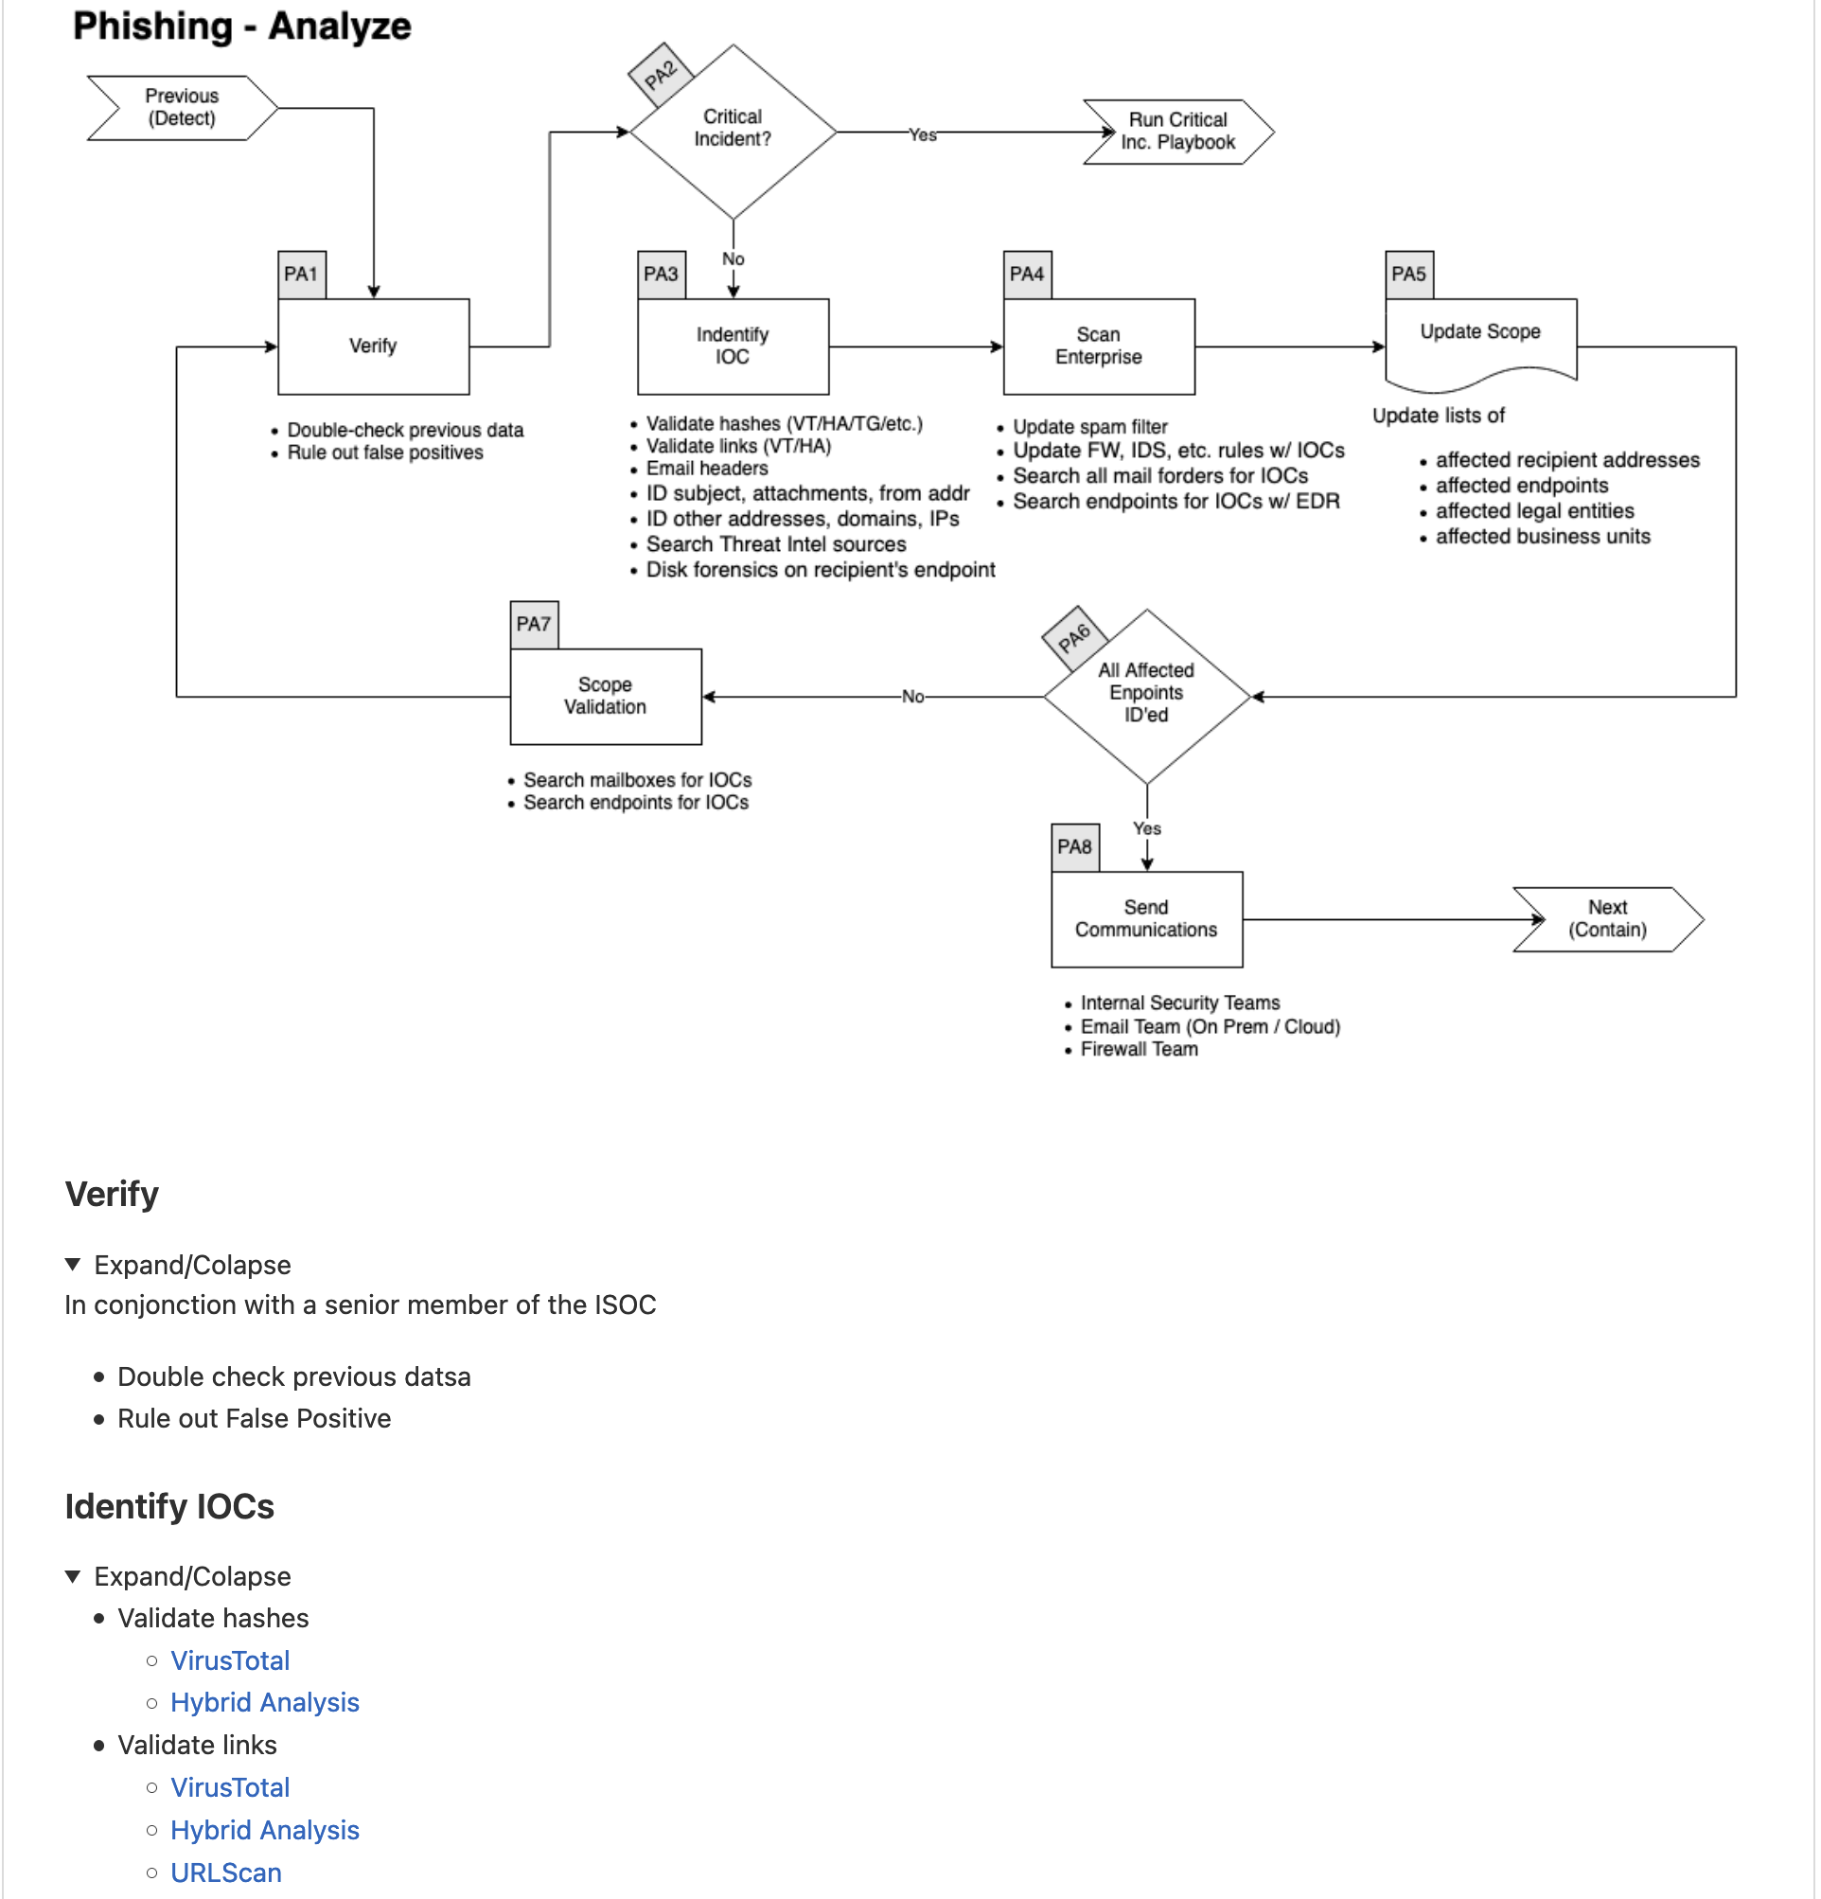
Syntax Playbooks
Git
Markdown / Draw.io
Open & Free
Easy to modify
Notes:
I hope it can become the Sigma or ART For more information

Slide 35

Training
For current and future staff
Easy to Consume
Video
Powerpoint
Wiki
Notes:
It’s not because you have master this technique that your analyst will understand what it means to see the OTM & Registry modified. If you do not do knowledge transfer, it’s pretty much useless

Slide 36

Bonus
Automate!
SOAR
Shuffle
Walkoff
VirusTotal
Greynoise
Spamhaus
Notes:
Security Orchestration, Automation & Response

Slide 37

Notes:
I liked this image. For me, it represent how we, the defender can stand up to the Red Team if we unite! We are bigger, we far outnumber them, and yet we are, in most cases, always trying to catch up with them.

Slide 38
Thank You!
Mathieu Saulnier / @ScoubiMtl
Notes:
I liked this image. For me, it represent how we, the defender can stand up to the Red Team if we unite! We are bigger, we far outnumber them, and yet we are, in most cases, always trying to catch up with them.

